Slide 1
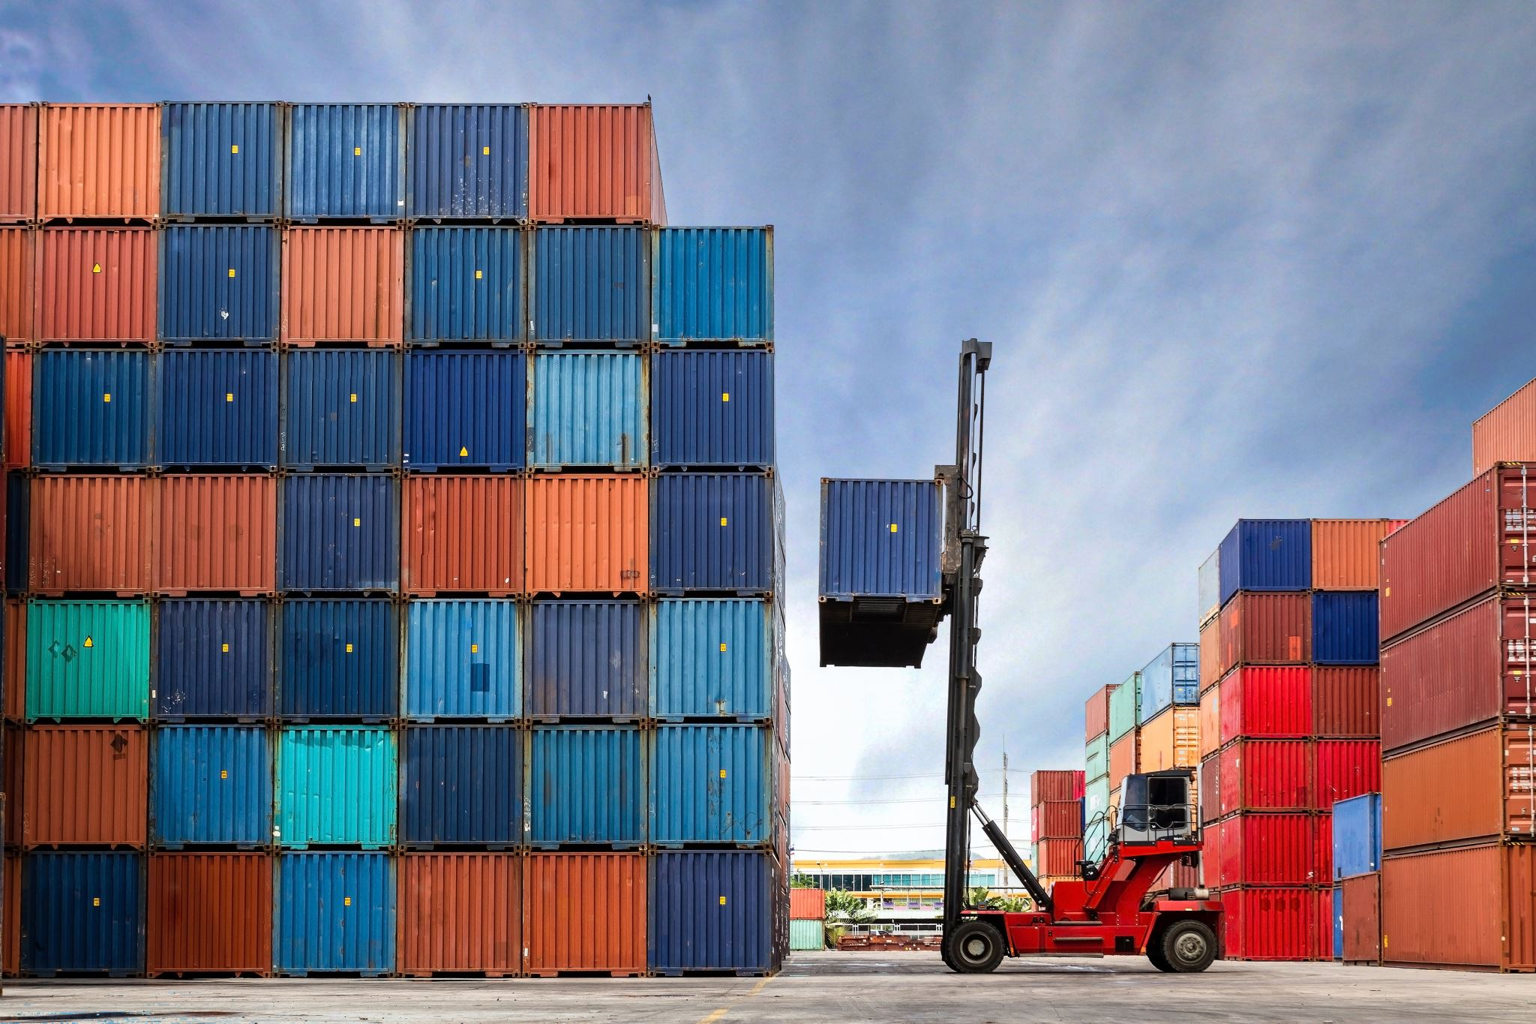
Cloudgineers
Jackson Gray
Carnell Greenfield
Jaden Jefferson
Nick Miller
Kelly Payne

Slide 2
Summary
Method: Using OpenStack and Kubernetes to set up a private cloud
Process: Install and configure software
Goal: Create a private cloud

Slide 3
Kubernetes & OpenStack
OpenStack
Set of open-source cloud computing software components
Which manage
Compute Resources
Storage
Orchestration
And many more cloud computing services.
Kubernetes
An open-source container management tool
Automates
Container deployment
Container scaling and descaling
Container load balancing.

Slide 4
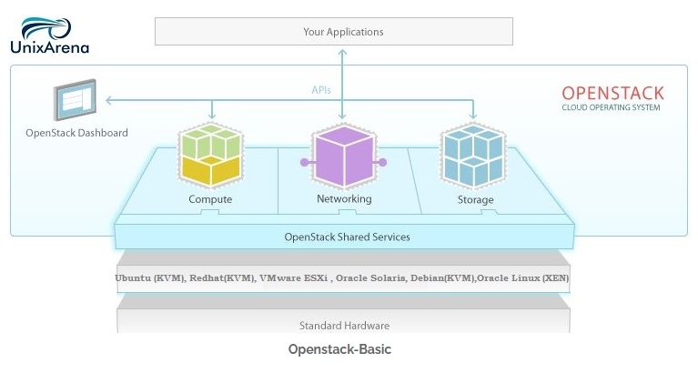
Basic Architecture

Slide 5
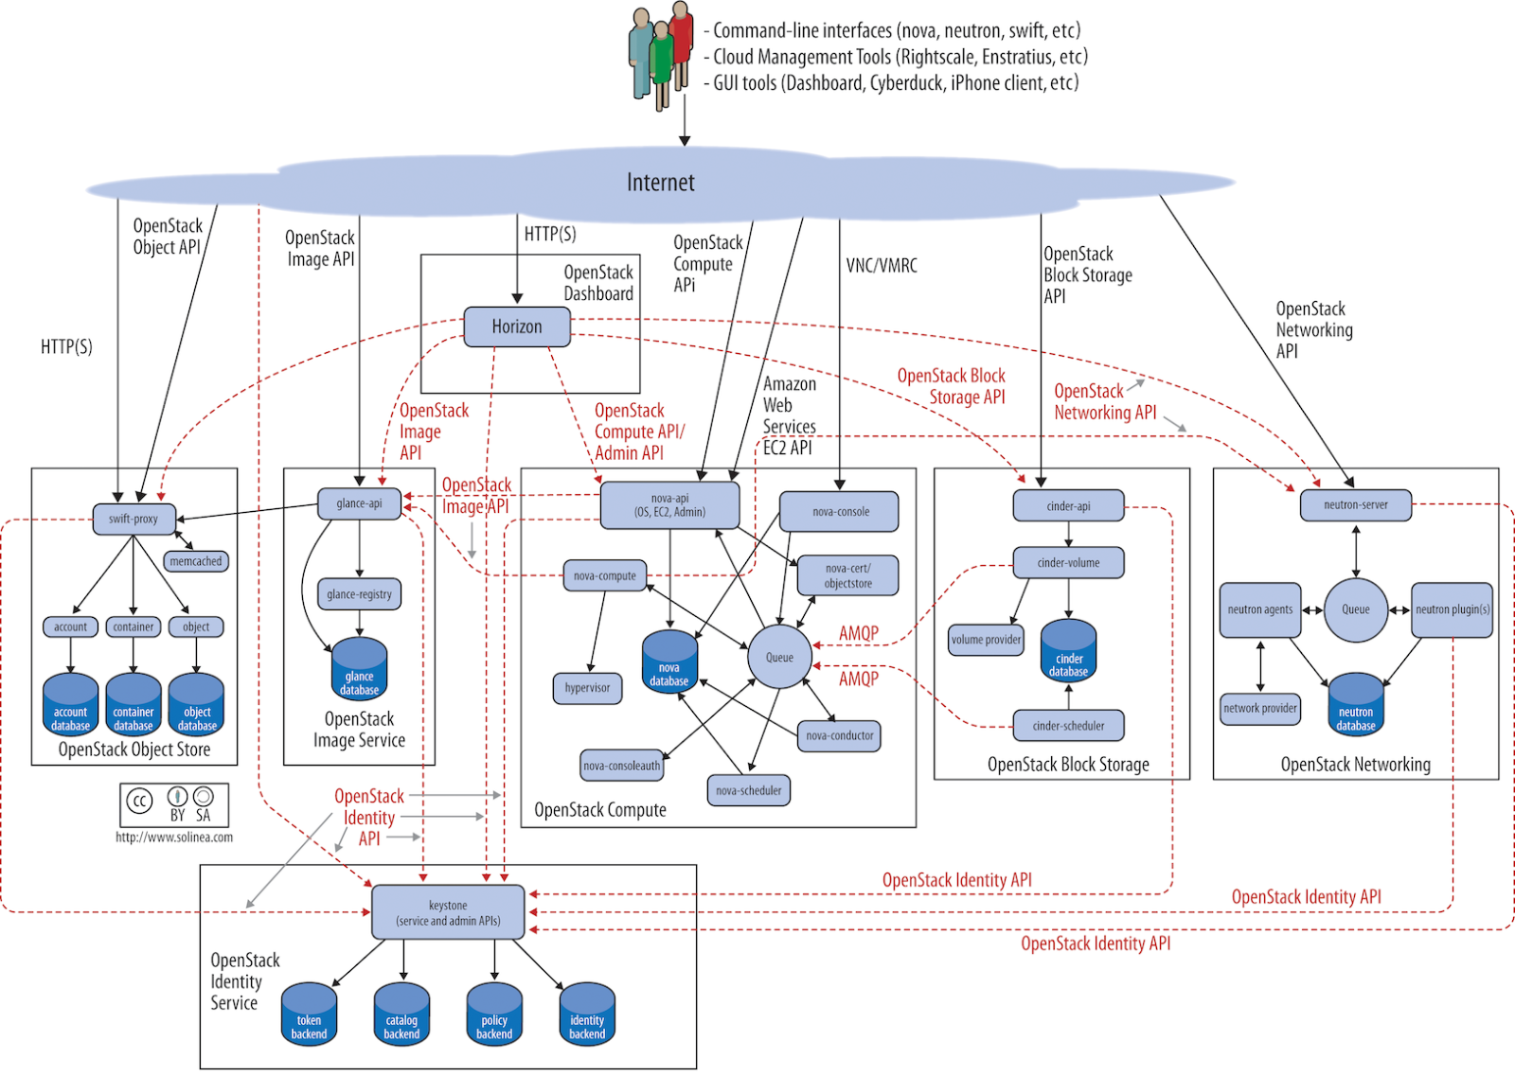
Complete OpenStack Architecture Model

Slide 6
Epics Worked On This Cycle
Physical Power Edge Servers
Linux Operating System
Dell Remote Access Controller
Server Network

Slide 7
Future Epics Being Pulled In For Cycle 2
ALL previous features
Rack Cabinet
OpenStack Playground
Base OpenStack Deployment
User Dashboard, Identity Access Management, Networking Serve, Computing Service, Imaging Service, Block Storage Service, Object Storage Service

Slide 8
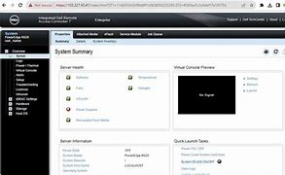
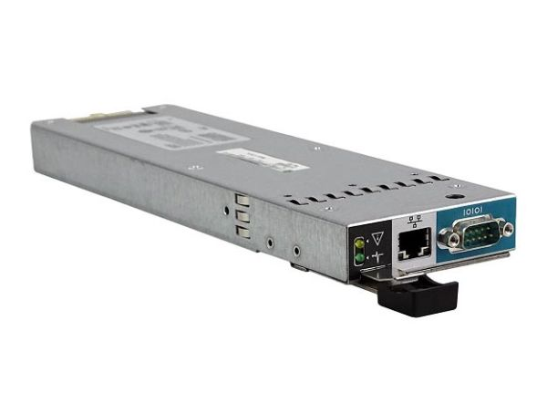
Dell Remote Access Controller
Installation and Walkthrough
RAID Configuration
Disk Encryption
IDRAC Server Profile
Hardware Monitoring
Virtual Media

Slide 9
Physical Power Edge Servers
Configure Wiring for all 3 servers
New coat of thermal paste applied to CPU heatsinks within servers
This feature is pretty straight forward for work needed. More stories may come from this

Slide 10
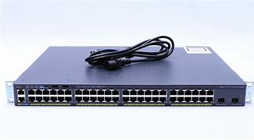
Server Network
Get IP Address Configured
Get LAN up and running
Restricted VLAN subnet for only 48 ports
Server Port-Based Address Allocation
Connect Servers to LAN
Setting up the overall physical and virtual network infrastructure for the servers and cloud platforms to be hosted on.

Slide 11
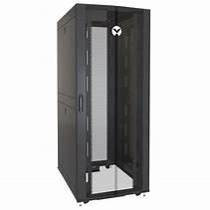
Server Room Setup: Rack Cabinet
Access Point to Enter Cabinet
Stabilizing Roll Out Trays
Inserting Dell Servers
Inserting Cisco Switch

Slide 12


OpenStack Playground
Provide a place of learning for both future OpenStack Sysadmins and Users
Miniature OpenStack environment to use as a playground.
A mini single node version of OpenStack for future engineers and developers to use and learn OpenStack in a supervised environment.
Users of this platform will learn how use key components such as Horizon, Nova, Keystone, Glance, Neutron, and Cinder.
POC: MicroStack
POC: DevStack
Single Node Deployment
Lab Creation

Slide 13
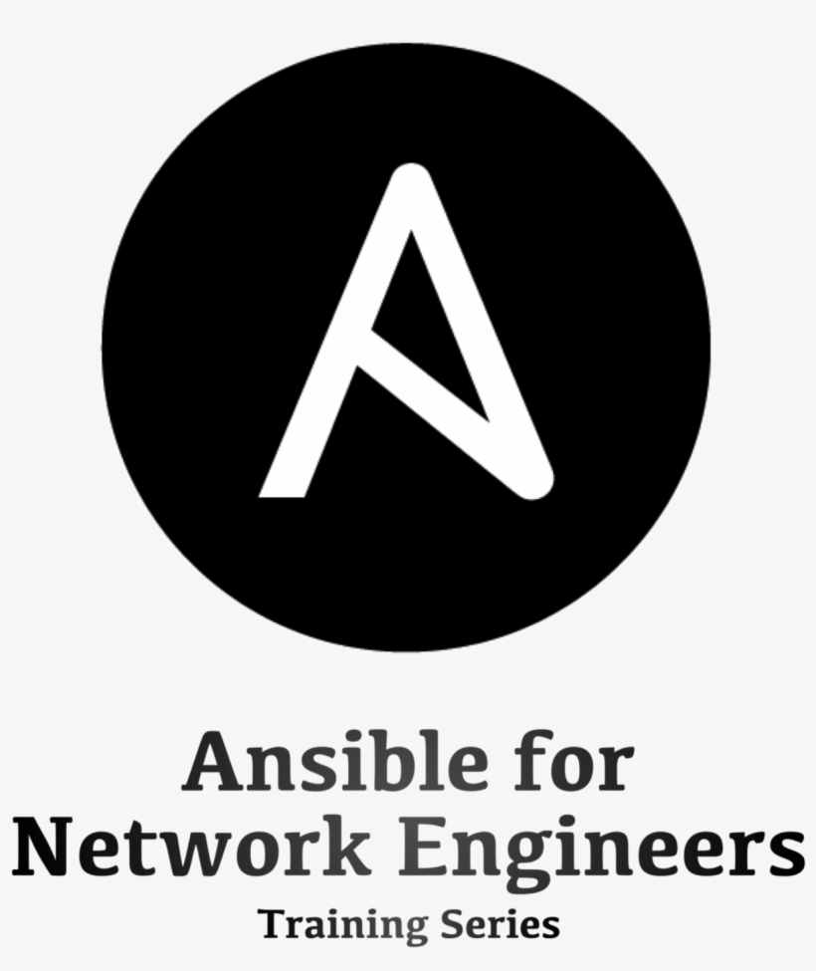

Base OpenStack Deployment
Future Stories currently being created
Further assessment and team discussion needed on definition of done for 'Base' deployment.
Will begin next sprint (4) on March 6th

Slide 14
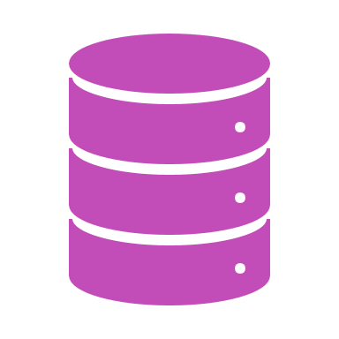
Other Epics
OpenStack Components
Continuous Learning
Continuous Improvements

Slide 15
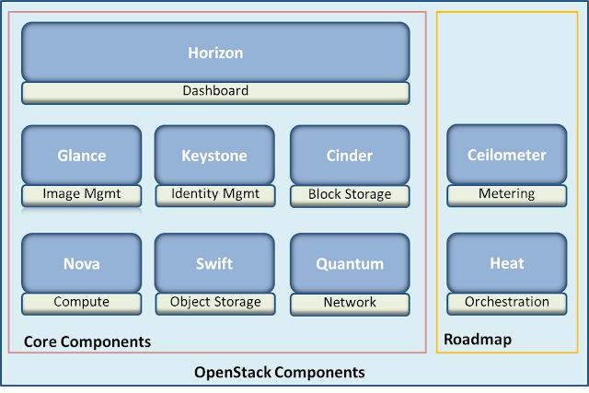
Other Epics/Features
Configuration and installment of each key component in OpenStack
Will begin sprint 5 on March 20th
User Dashboard
Identity Access Management
Networking Service
Computing Service
Imaging Service
Block Storage Service
Object Storage Service
Neutron

Slide 16

Continuous Learning
We have continuous learning as we investigate OpenStack and all the components that are included.
ThePhoto by PhotoAuthor is licensed under CCYYSA.

Slide 17

Continuous Improvements
Hardware Requests-1
As we progress, through our project we will include more task.
ThePhoto by PhotoAuthor is licensed under CCYYSA.

Slide 18
Stories from Sprint 1
Story | Summary | Hours | Overall Status
Research Kubernetes and Initial OpenStack Findings | Actively researching OpenStack software and private cloud setup options. | P: 1 A: 1 | Collab
Access for desktop | Requesting access to desktop so that we can download needed software and sign in directly to servers. | P: 2 A: 2 | Collab
Configure wiring for Dell PR710/30 | Downloaded manuals for each system and reading to see how the servers are connected | P: 3 A: 3 | Collab
Get network up and running | When the software is downloaded and systems are configured, we should be able to access the server remotely. | A:4 P:- | Collab
Operating System Installation | Linux is the operating system we are installing. | P: 2 A: 2 | Collab

Slide 19
Stories from Sprint 2
Story | Summary | Hours | Overall Status
Operating System Installation | Linux is the operating system we are installing. | P: 2 A: 3 | Done
KVM installation | Configuration and installation of KVM | P: 2 A: 2 | Done
IDRAC6 Installation and Walk through | The IDRAC6 basic configurations for settings | P: 2 A: 2 | Done
Find COM Port for 2960-SC Switch | Download port driver to connect to Switch | A: 1 P: 1 | Done
Check for RAID configurations | Check to make sure RAID has been downloaded on all three servers and that the basic configurations are in place. | P: 3 A: 4 | Done
Get LAN Up and Running | Port driver installation to get LAN up and running | P: 4 A: - | Collab

Slide 20

Management Plans
Identify and evaluate areas for improvement
Knowledge gaps, potential roadblock
Proactively address issues moving forward
Address improvements through individual tasks
Connect back to team-oriented stories
Continuous Research and Learning
All engineers
Sharing findings with the group
Continuous Improvements
Documentation for process of developing a cloud
End of Cycle
Hour adjustments and cumulative reporting

Slide 21

Risk Analysis & Mitigation
Primary risk: Lack of time for team members to work on project
Look ahead and plan around individual schedules
Communicate early with team about conflicts
Secondary risks: Hardware failures, organizational meddling, requirement issues
Organization is not unpredictable
Requirements are loose, time frame is forgiving

Slide 22

What did we learn?
How to configure the iDRAC for the servers and that iDRAC6 has much more involvement than we realized
How to download and install Ubuntu on a flash disk
Not to initialize the RAID as that will cause you to have to reinstall Ubuntu and KVM again.

Slide 23

Conclusions:
The OpenStack and iDRAC6 are more detailed than we realized however when we get these uploaded and configured our private cloud will be up and running.

Slide 24

Q & A

